Slide 1

KAKATIYA INSTITUTE OF TECHNOLOGY AND SCIENCE FORWOMEN
DEPARTMENT OF COMPUTER SCIENCE ENGINEERING
DEPARTMENT OF COMPUTER SCIENCE ENGINEERING
PRESENTED BY:JAVA
A5 BATCH

Slide 2
EFFICIENT PROACTIVE RECOVERY IN ERASURE-CODED CLOUD STORAGE SYSTEMS
INTERNAL GUIDE:
Mr B.L.VINAY KUMAR
PROJECT MEMBERS:
G.SUPRIYA 216B1A0530
B.SAI SUPRIYA 216B1A0516
K.BINDHU 216B1A0550
K.HARSHITHA 216B1A0552

Slide 3

CONTENTS:
Abstract
Introduction
Existing system
Proposed system
System Requirements
System Architecture
System Design
Design Phase
Result
Conclusion

Slide 4
ABSTRACT:
Cloud data centers have started utilizing erasure coding in large-scale storage systems to ensure high reliability with limited overhead compared to replication.
Cloud storage systems also play an important role in the energy consumption of data centers.
To address this issue, we propose a recovery algorithm that applies minimization on data blocks selected for proactive replication by considering the necessary and appropriate constraints that are constructed based on the system’s current network traffic and data duplication information.
We evaluate the proposed algorithm using extensive simulations.
Experiments show that the recovery algorithm reduces network traffic by 60% and storage overhead by 46% compared to the heuristic proactive recovery approach.
Also, the proposed proactive recovery methods reduce the storage system’s energy consumption by up to 52% compared to replication.

Slide 5
INTRODUCTION:
Cloud storage system is an aggregation of individual hardware components that are subject to failure.
Erasure coding is a viable alternative to replication.
The most common data redundancy techniques are replication and erasure coding.
In order to ensure data reliability, any failed data block in the cloud storage system has to be restored. The process of recovering failed data blocks is known as data recovery.
In order to avoid unnecessary repairs of short-term transient node failures, data recovery is delayed for a certain amount of time.
However, proactive recovery methods suggest additional temporary dedicated storage overhead that may increase system energy consumption.

Slide 6
EXISTING SYSTEM:
In Traditional system uses replication where multiple copies of same data is stored on different disks. So, that if one copy is lost another copy is used for recovery but this leads to more storage space and Bandwidth.
Bandwidth –The amount of data that can be transmitted over a network in given amount of time
Heuristic-Based Proactive Recovery ,In this some systems predict disk/machine failure in advance and initiate proactive replication by copying all data blocks.
Here all data blocks are replicated even when some of them might be necessary for recovery.
However due to replication of all data blocks it effects performance of the system and increases Network Bandwidth and energy consumption.

Slide 7
PROPOSED SYSTEM:
This reduces network traffic and storage space significantly and also improves system performance.
We proposed a cloud storage system that employs several proposed bandwidth-efficient proactive recovery methods.
Proposed system selects an appropriate proactive recovery method. This heuristic proactive recovery technique selects a set of data blocks for proactive replication according to the selected recovery method.
As system chooses selective data blocks for replication ,it reduces the storage space. This results in 60% reduction of network traffic,46% reduction in storage space and 52% in energy consumption
We observed that our recovery approach improves repair bandwidth efficiency and reduces network traffic in cloud storage systems with limited storage overhead compared to existing recovery approaches.

Slide 8
MODULE:
Data Owner
In this module, the data owner uploads their data with its File Blocks block in the cloud server. For the security purpose the data owner encrypts the data File Blocks and then store in the cloud.The Data owner can have capable of manipulating the encrypted data File Blocks. And the data owner can set the access privilege to the encrypted data File Blocks.
Cloud Server
The cloud service provider manages a cloud to provide data storage service. Data owners encrypt their data File Blocks and store them in the cloud for sharing with data consumers. To access the shared data File Blocks, data consumers download encrypted data File Blocks of their interest from the cloud and then decrypt them.
Third Party Auditor
Third party auditor (TPA), who has capabilities to manage or monitor the outsourced data under the delegation of data owner, who has expertise and capabilities that a common user does not have, for periodically auditing the outsourced data. This audit service is significantly important for digital forensics and credibility in clouds and setting time period to update the old secret keys to new secret
End User
The Cloud User who has a large amount of data to be stored in cloud and have the permissions to access and manipulate stored data and performs the following operations such as Searches for File Blocks based on Content’s keyword, Requests for File Blocks, Request File Blocks for downloading with current sec key for the corresponding File Blocks from the cloud and dec, download

Slide 9
SYSTEM REQUIREMENTS:
SOFTWARE REQUIREMENTS:
Operating System – Windows XP
Coding Languages – Java/J2EE(JSP, Servlet)
Front End – J2EE
Back End - MySQL

Slide 10
SYSTEM REQUIREMENTS:
HARDWARE REQUIREMENTS:
Hard Disk
Key Board
Mouse
Monitor
Processor
RAM

Slide 11
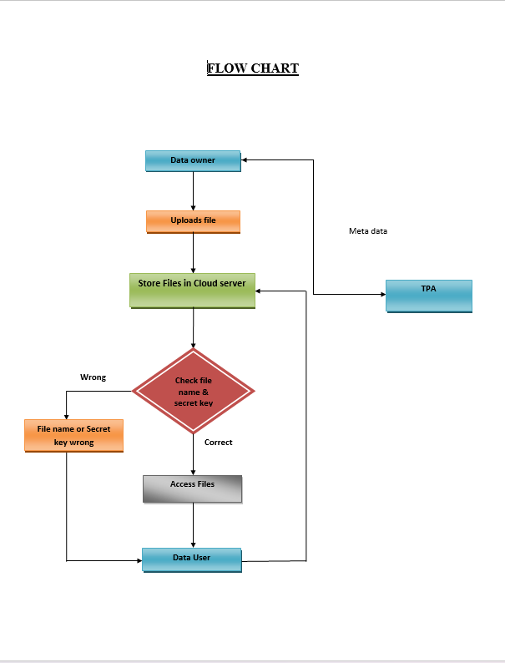
FLOW CHART:

Slide 12
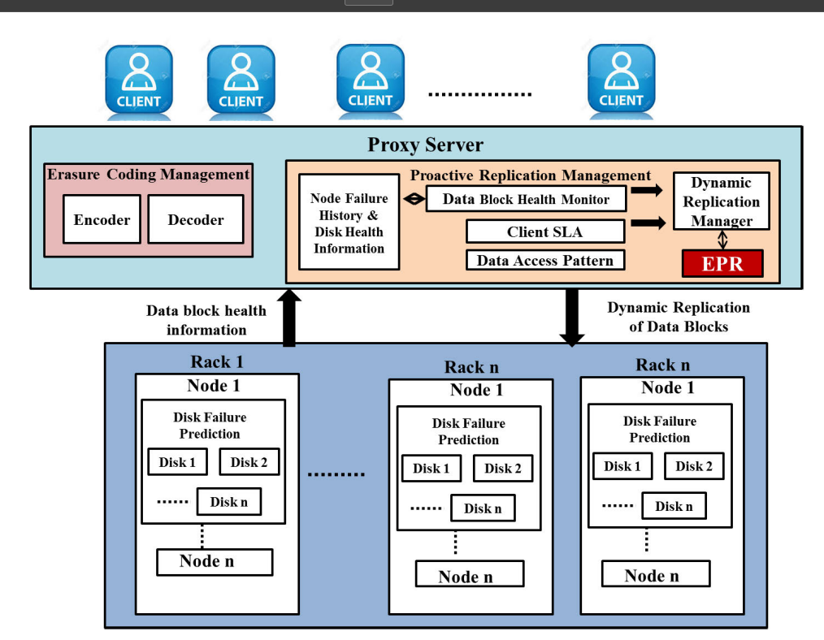
SYSTEM ARCHITECTURE:

Slide 13
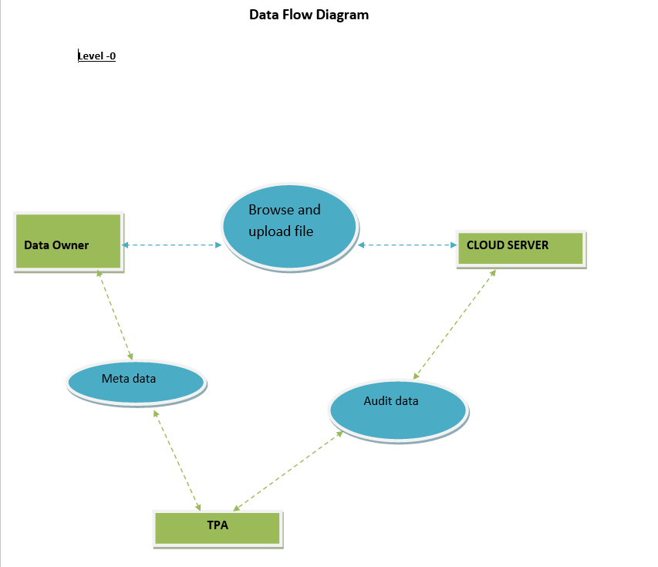
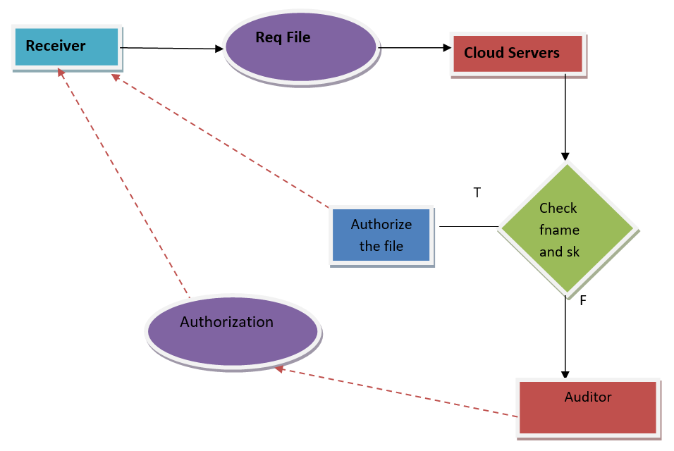
DATA FLOW DIAGRAM:
LEVEL-0
LEVEL-1

Slide 14
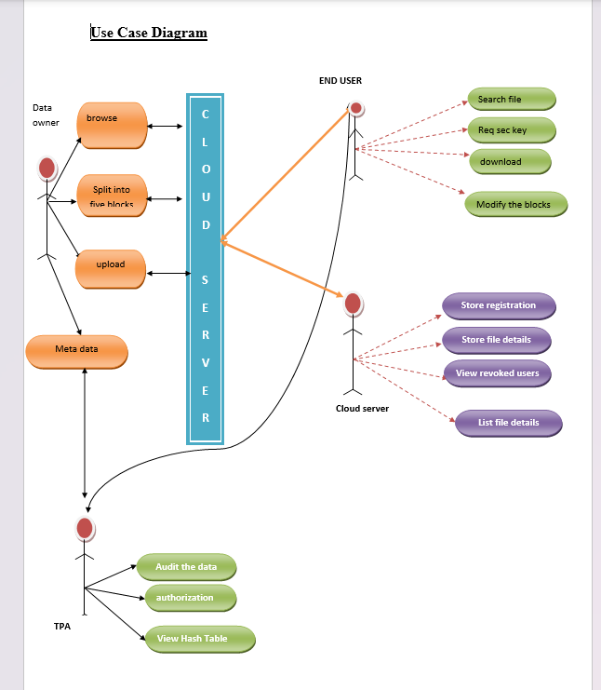
USE CASE DIAGRAM:

Slide 15
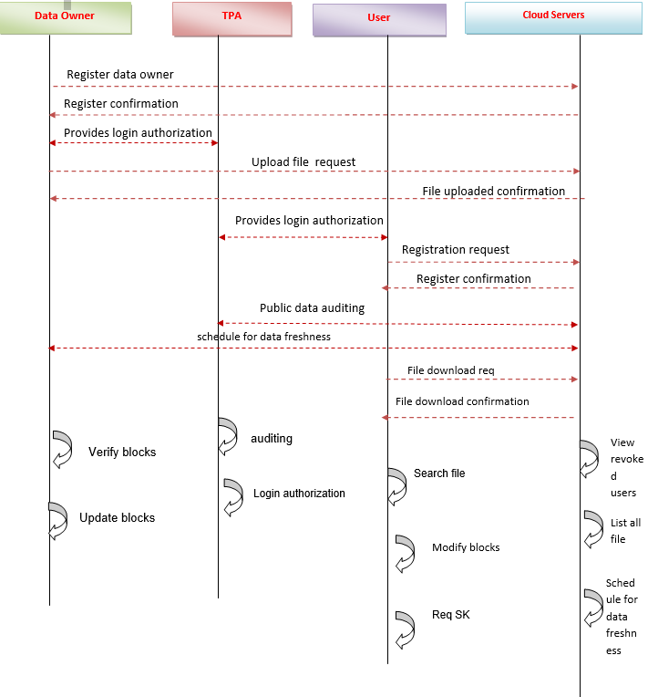
SEQUENCE DIAGRAM:

Slide 16
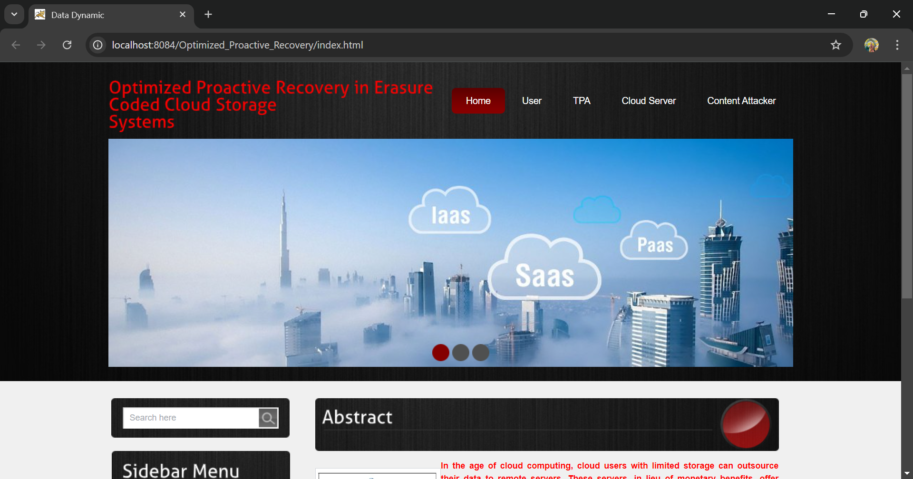
SCREENSHOTS:

Slide 17

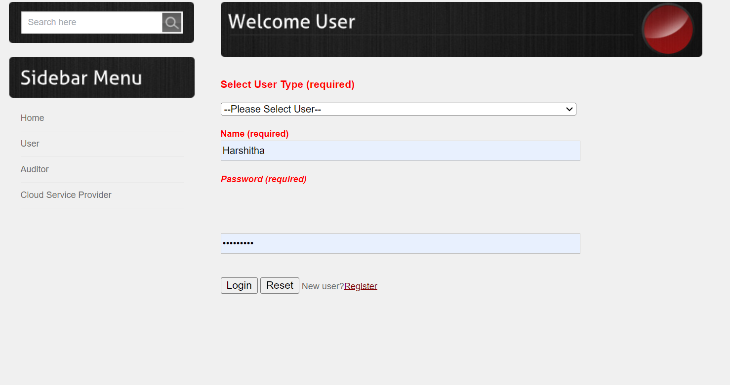
SCREENSHOTS:

Slide 18
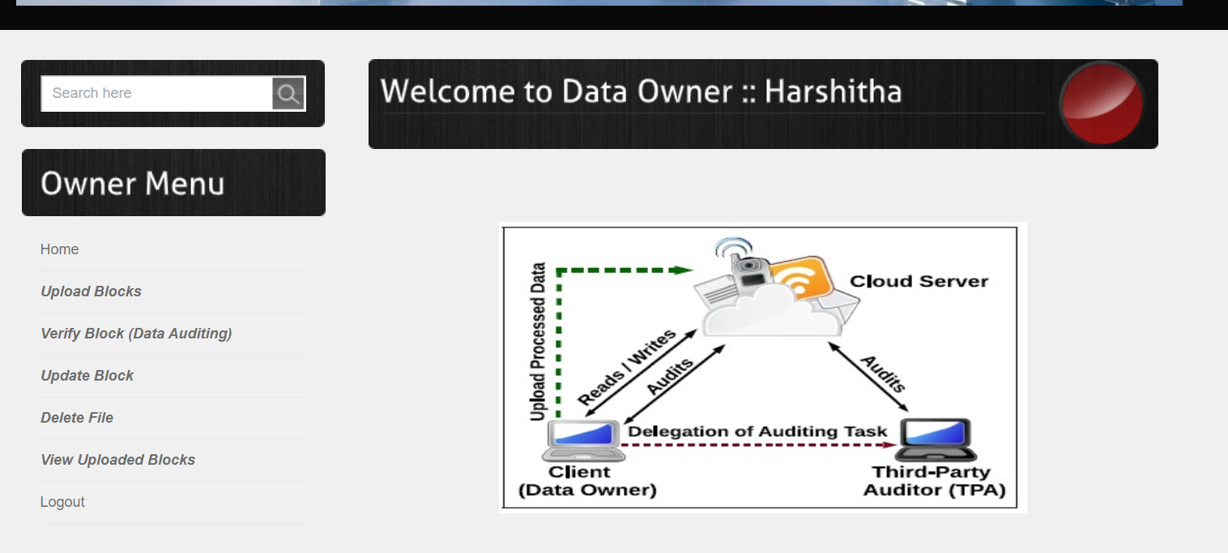
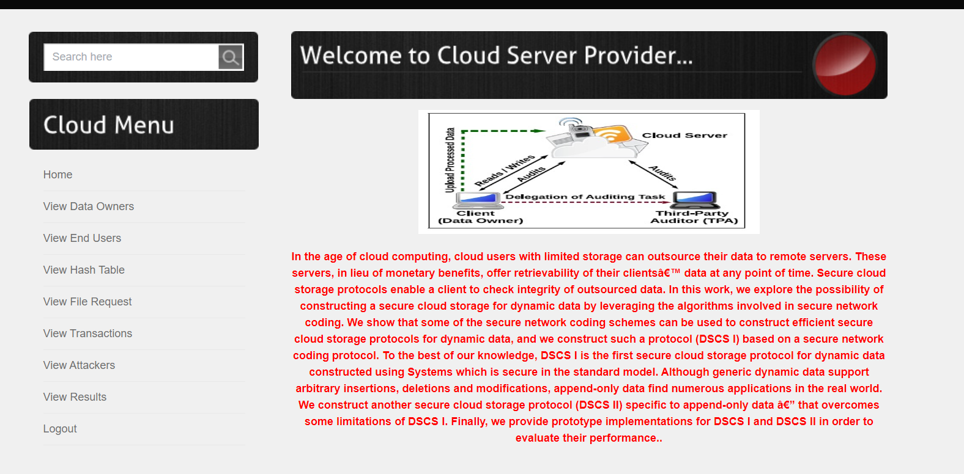
SCREENSHOTS:

Slide 19
CONCLUSION:
In this project, we explore new proactive recovery approach which significantly improves efficiency of cloud storage systems, reducing bandwidth and energy consumption, this improves the system performance

Slide 20
THANK YOU

